Slide 1
Templates
CS 201, Summer 2013

Slide 2
ADDITIONAL READING
Template Classes
  Chapter 16 of Pearson book
  http://www.cprogramming.com/tutorial/templates.html
  http://www.cplusplus.com/doc/tutorial/templates/
  http://www.learncpp.com/cpp-tutorial/143-template-classes/

Slide 3
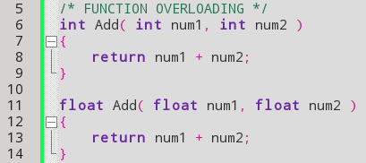
Reusing a Function
Up until now, if we wanted to write something like an “Add” function and have it work with both floats and ints, we would have to use function overloading:

Slide 4
Reusing a Function
But if we were to use this method, any time we wanted to add two numbers together we'd have to define another version of Add!

Slide 5
Reusing a Function
Instead, we can write the Add function in a way that you can use any data-type, so long as the operator+ is available or has been overloaded!
(Drumroll...)

Slide 6
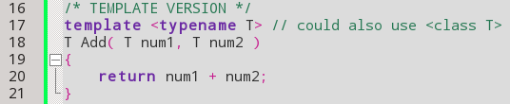
Reusing a Function
By making the Add function a template function, we can now use any datatype!
Before the function, we add
template <typename T>
Then, we can use “T” as a generic name for any datatype.
The “T” name is arbitrary and you can choose whatever you want, but “T” is pretty standard.

Slide 7


Reusing a Function
Old method – Overloading
New method – Templates!

Slide 8
Reusing a Function
The only thing we need to add to our standard function call is the < and > container, with a data-type inside.
This data-type can be primitives (int, float) or classes (string, BankAccount, Fraction, etc.)
If the data-type you pass doesn't have the operator+ available in this case, we will get a compile error.

Slide 9
Template Classes
You can also use Templates with a Class.
You can still have member variables of any data-type, but you would use the “T” generic data-type for something the class may revolve around. For example, a List.
Think of a container that can hold anything; you can have a class that holds any data-type.

Slide 10
Template Classes
Note that with Template Classes you must define your function bodies within your .h file.
  This is because the compiler looks at where our Template Class is used, and for each data-type implemented it creates separate classes of these types.
  List<int>, List<string> will be turned into an int version and string version, but since nothing else is used, it won't bother creating a float list class.
Luc Touraille

Slide 11
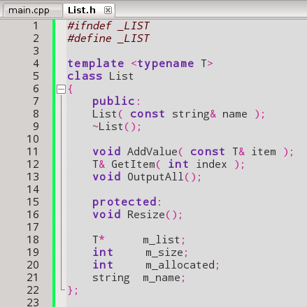
Template Classes
We use the template keyword prior to the class declaration.
Then, within the class, we can use “T” as the generic data-type.
Notice that we can still use other data-types as well, but since this is a list of “Some Object”, we're only using the generic “T” when referring to our list of “some type” of items.

Slide 12
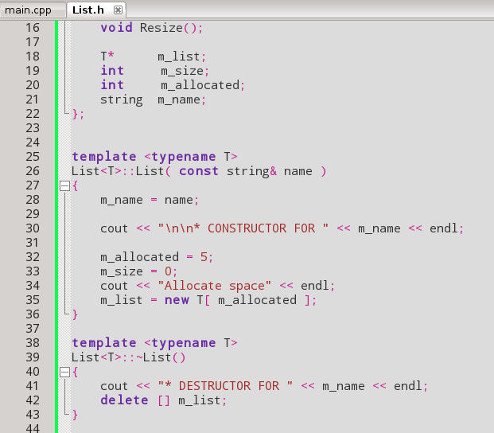
Template Classes
Notice that we have to define our class functions within the List.h file.
Need to add the
template <typename T>
Before each function.
Instead of prefixing the function names with List::, we use List<T>::

Slide 13
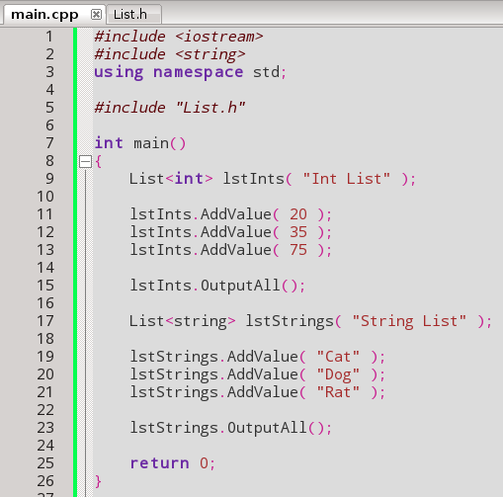
Template Classes
Then we can use our List template class elseware, simply referencing what data-type to use during the declaration of our List variable.

Slide 14
References
Luc Touraille
StackOverflow.com
http://stackoverflow.com/questions/495021/why-can-templates-only-be-implemented-in-the-header-file

